Slide 1


Introduction
This presentation was made for the company Rockbuster Stealth LLC, a movie rental company that used to have stores around the world.
At a time when streaming platforms are gaining more and more space in the market, Rockbuster Stealth management team is planning to use its existing movie licenses to launch an online video rental service in order to stay competitive.

Slide 2

What can our data bring to us?
Which movies contributed the most/least to revenue gain,
What was the average rental duration for all videos,
Which countries are Rockbuster customers based in,
Where are customers with a high lifetime value based,
Do sales figures vary between geographic regions.

Slide 3
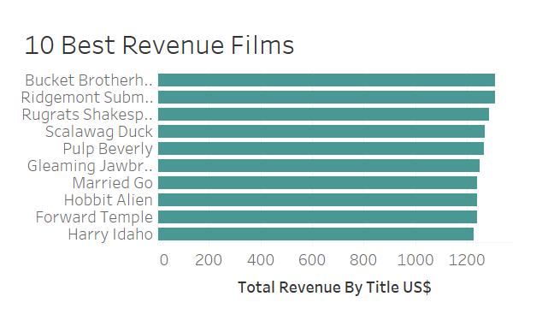
Which movies contributed the most revenue gain?

Slide 4
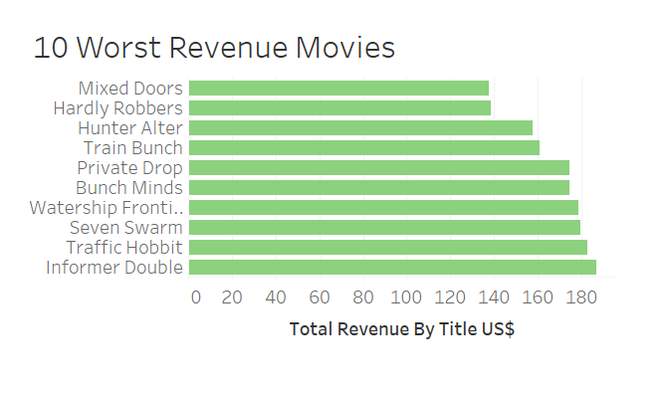
And the worst?

Slide 5
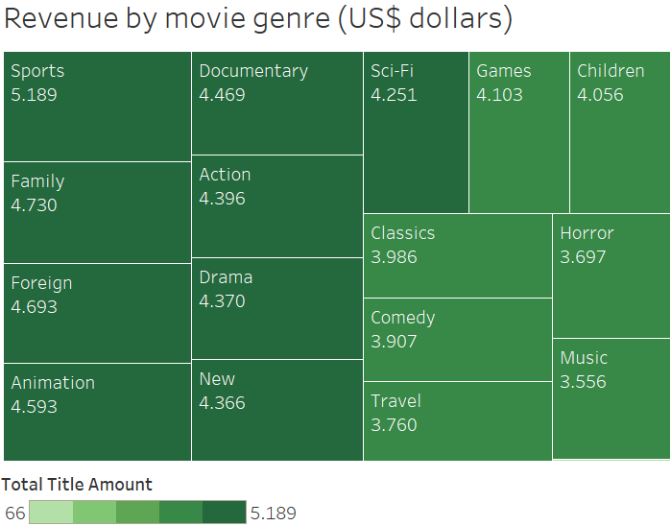
Which are the most popular movie genres?
The tree chart shows that the most popular movie genre is Sport!

Slide 6
What was the average rental duration for all videos?
Rental Duration by Client | Time
Minimum time | 7 days
Maximum time | 3 days
Average time | 5 days
How much Money did a client spend by movie in average?
US$ 2,98

Slide 7
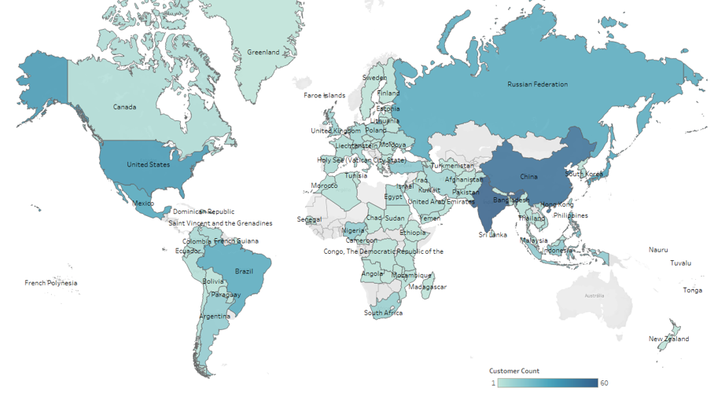
Where are Rockbuster’s customers based in?
Darker colours represent countries with the biggest number of customers.

Slide 8
Where are customers with a high lifetime value based?
Customer id | First Name | Last Name | City | Country | Amount Paid US$ dollars
512 | Cecil | Vines | London | United Kingdom | 115.74
424 | Kyle | Spurlock | Shanwei | China | 109.71
240 | Marlene | Welch | Iwaki | Japan | 106.77
40 | Amanda | Carter | Nador | Morocco | 105.74
407 | Dale | Ratcliff | Rustenburg | South Africa | 104.74

Slide 9
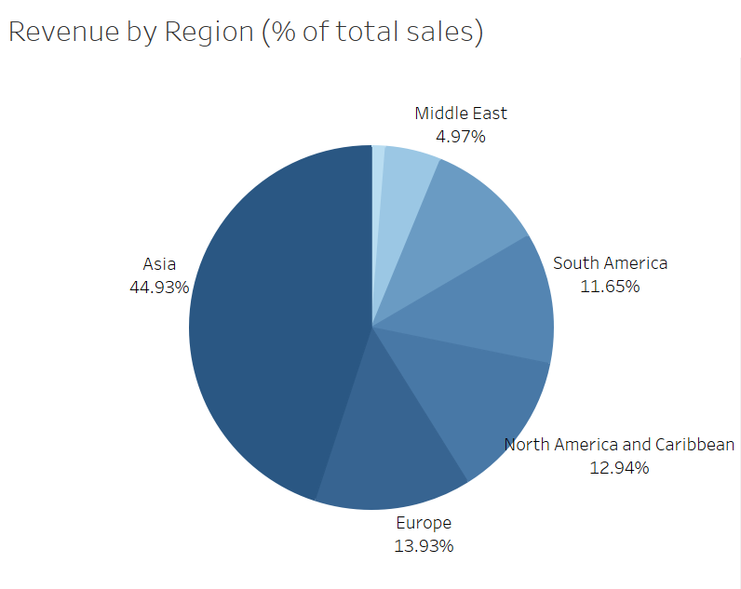
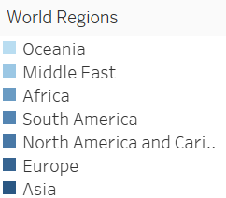
Do sales figures vary between geographic regions?
Asia is the most important region!

Slide 10
recomendations
For an improvement in Rockbuster's sales strategy it is recommended that:
  Evaluate annually which films are most watched and least watched. Less watched films can be removed from the platform, giving place for new ones.
  Make investments in the genres with the highest audience, increasing the offer of films and series.
  Increase the offer of original films and in the languages of the regions with the highest audience conducting marketing research on preferences in these regions.
  As a customer retention strategy, offering bonuses or discounts on subscriptions to customers with good loyalty, with high payment rates and who remain on the platform for a long time.
  Give discounts to customers who rent movies for a longer time.

Slide 11
Questions?
Contact: Mariana Oliveira (Rockbuster data strategy team)
Email: marigesualdo@hotmail.com,

